Slide 1
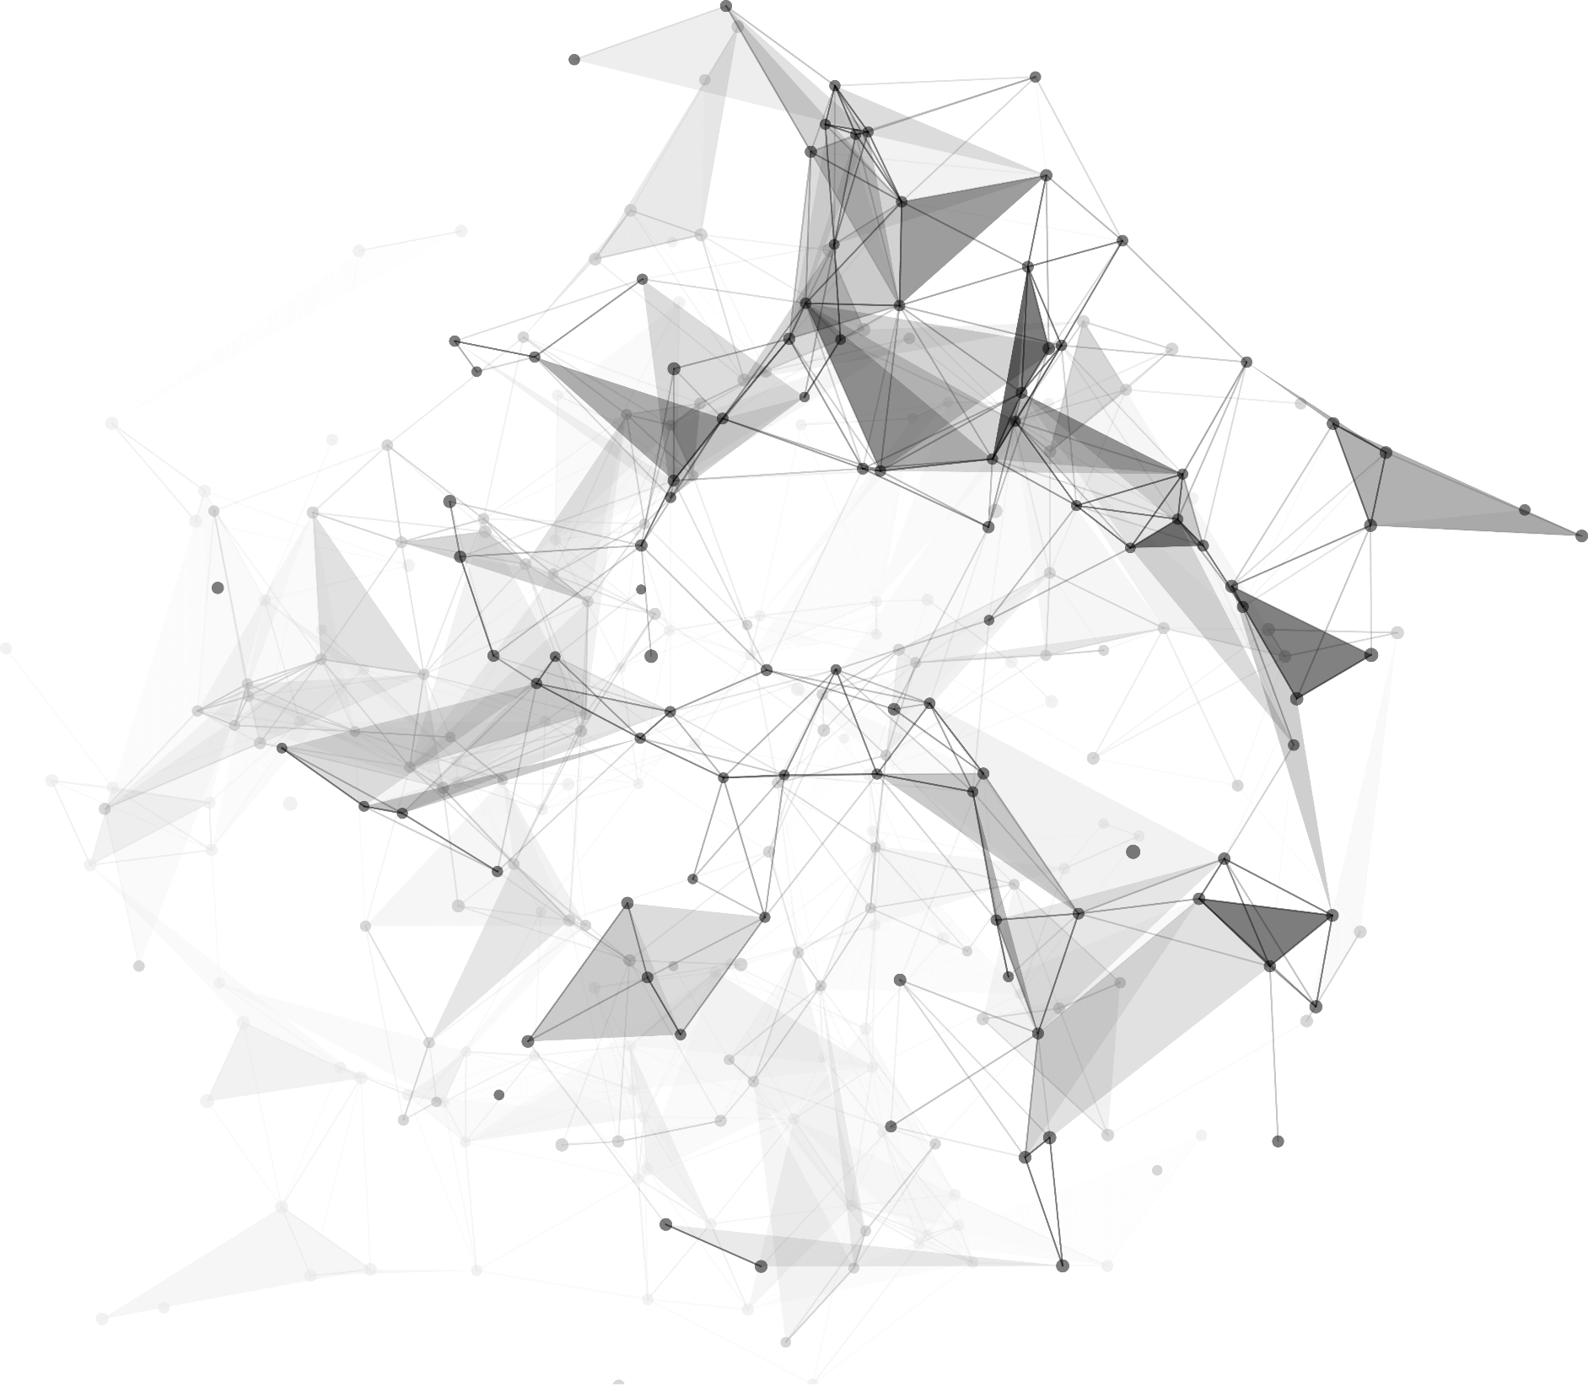
Attention
Group 2
Qianyi Xue, Kejia Liu, Yuchen Ge, Longxin Wang

Slide 2
“Attention is all you need” (Vaswani et al., 2017).
Self-attention etc.
RNNs & limitation
01
03
04
02
Applications
Attention

Slide 3
1
Recurrent Neural Network (RNN)

Slide 4
01
Key principles behind RNNs
How RNN computation works
Pros & Cons

Slide 5
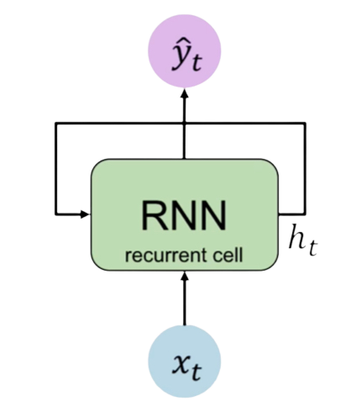
01
output vector
COMPANY
hidden state
input vector
Allow for information to persist over time
Pass this information about its internal state from this time step of the network to the next

Slide 6
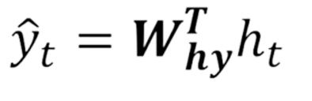
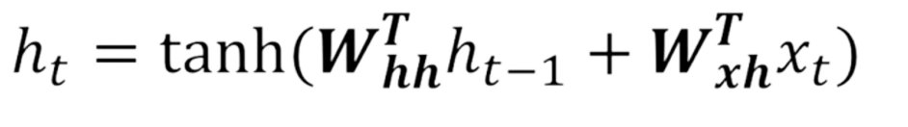
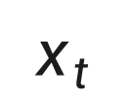
01
RNN State Update and Output
Output Vector
output vector
COMPANY
Update Hidden State
hidden state
input
vector
Input Vector
$$x_{t}$$

Slide 7
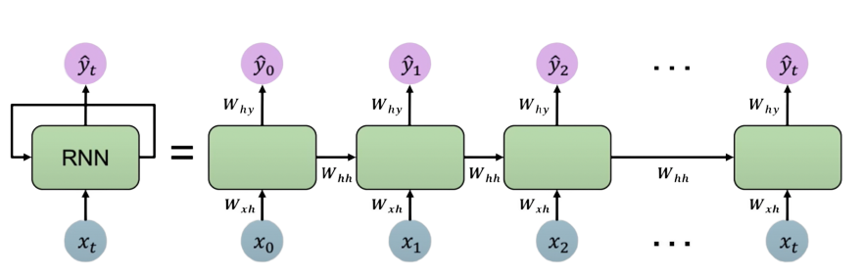
01
RNNs: Computational Graph Across Time
W: weight matrix
Use the same weight matrices at every time step

Slide 8
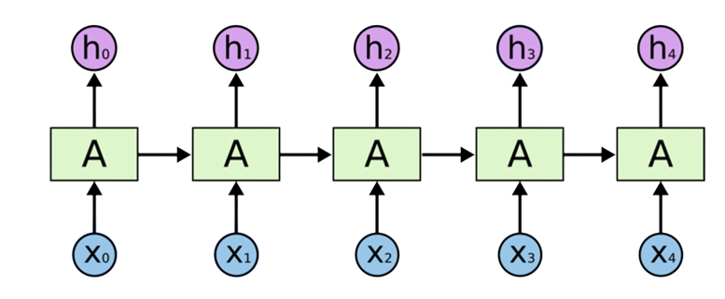



01
Pros
Predicted next words:
sky
Input text:
clouds
are
in
the
Only need to look at a few most recent inputs to predict
Therefore, SimpleRNN is good at short term dependence

Slide 9
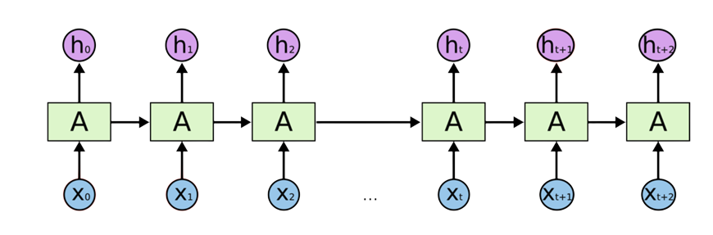
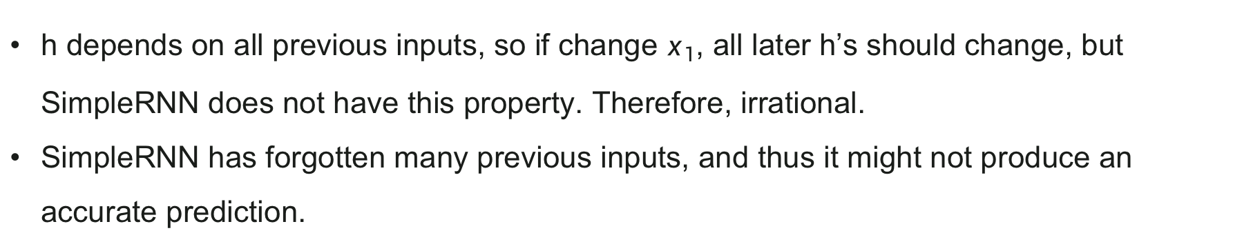



01
Cons: bad at long-term dependence
h depends on all previous inputs, so if change $x_{1}$, all later h’s should change, but SimpleRNN does not have this property. Therefore, irrational.
SimpleRNN has forgotten many previous inputs, and thus it might not produce an accurate prediction.

Slide 10
2
Part 02
Attention without RNN

Slide 11
02
Introduction to Seq2Seq Model
A best illustrating example of Seq2Seq Model is translation.
Attention for Seq2Seq Model
Attention is a mechanism of enhancing long-term dependence.
Attention without RNN
You can build up the structure of attention layer anyway!

Slide 12
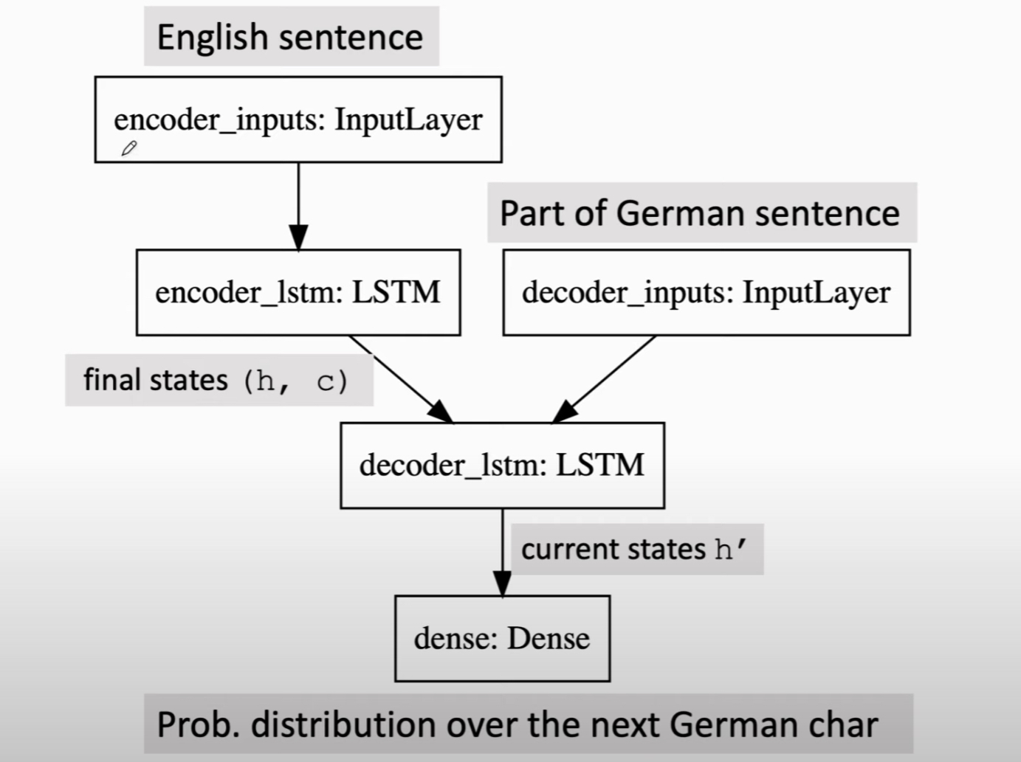
02
Introduction to Seq2Seq Model
An illustrating example of Seq2Seq Model is the translation machine which composes of two LSTM, namly encoder and decoder, connected by the finial states ( h, c ) with the final output being the one-hot vector implying the distribution over the next German char.

Slide 13
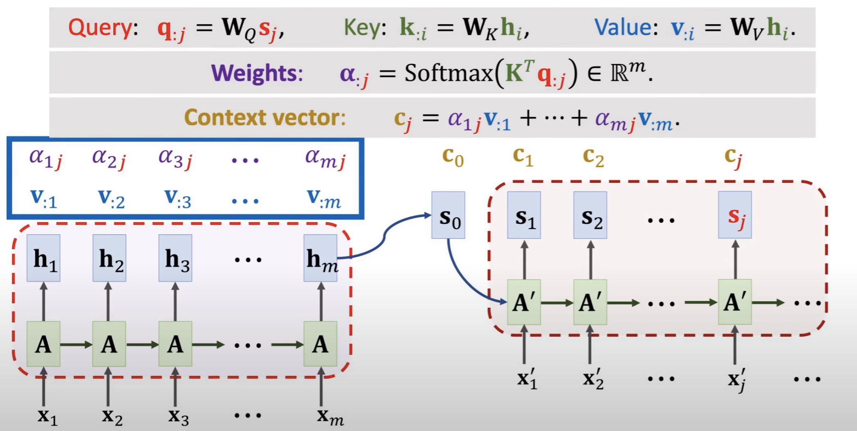
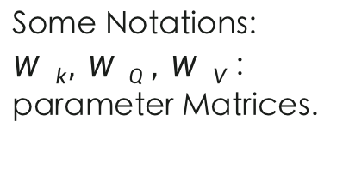
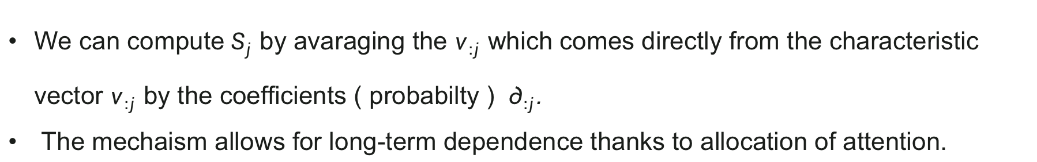
02
Attention for Seq2Seq Model
Some Notations:
${{W }_{k}, W }_{ Q} , {W }_{V}$: parameter Matrices.
We can compute $S_{j}$ by avaraging the $v_{:j}$ which comes directly from the characteristic vector $v_{:j}$ by the coefficients ( probabilty ) $∂_{:j}$.
The mechaism allows for long-term dependence thanks to allocation of attention.

Slide 14
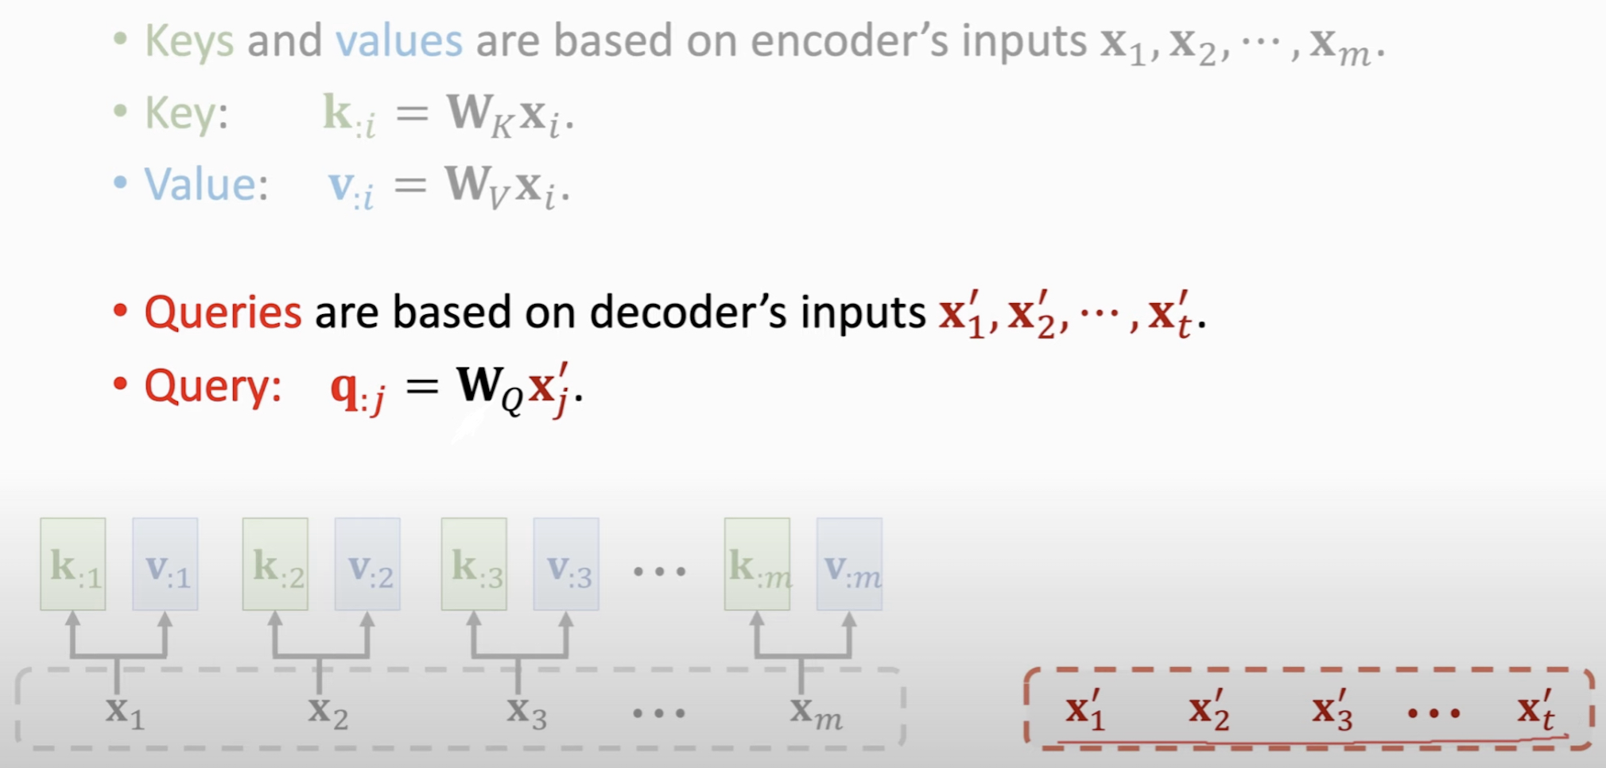
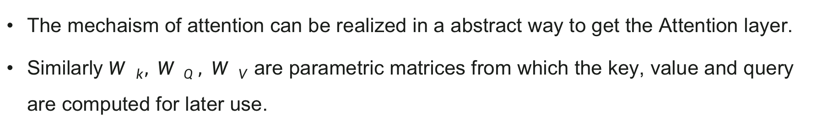
02
Attention without RNN
The mechaism of attention can be realized in a abstract way to get the Attention layer.
Similarly ${{W }_{k}, W }_{ Q} , {W }_{V}$ are parametric matrices from which the key, value and query are computed for later use.

Slide 15
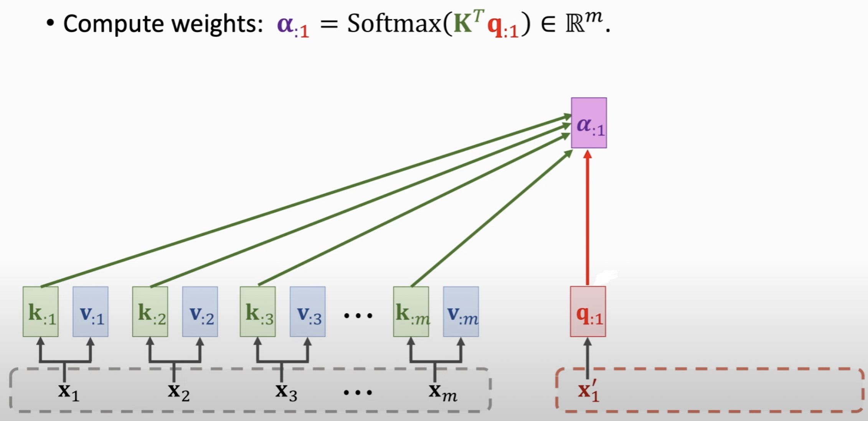
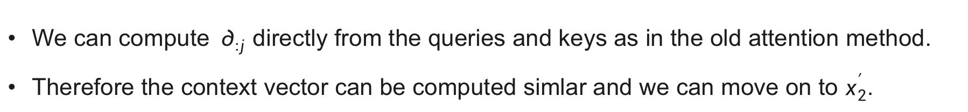
02
Attention without RNN
We can compute $∂_{:j}$ directly from the queries and keys as in the old attention method.
Therefore the context vector can be computed simlar and we can move on to $x_{2}^{′}.$

Slide 16
3
Part 3
Varieties of Attention

Slide 17
03
Self-Attention
S
Vision Transformer (VIT)
V
M
Multi-head Self-Attention

Slide 18
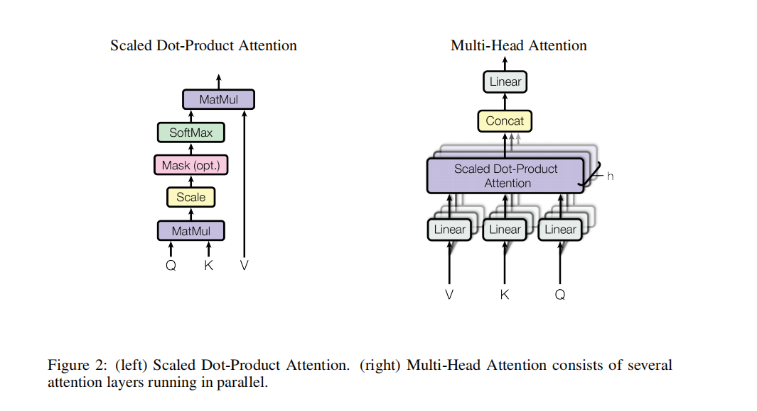
03

Slide 19
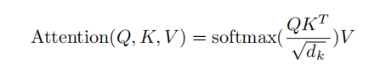
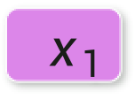
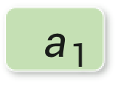
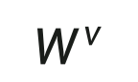
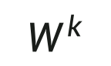
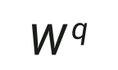
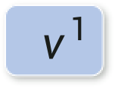
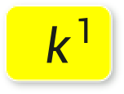
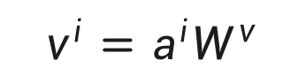
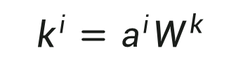
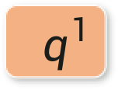
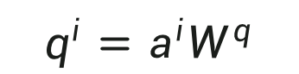



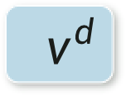
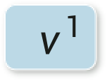
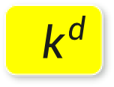
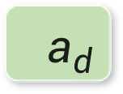
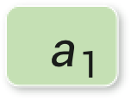
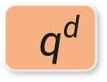
03
q: query(to match others)
k: key(to be matched)
v: information to be extracted
Self-Attention
$${ q}^{1}$$
$${ a}_{1}$$
$${ q}^{1}$$
$${ k}^{1}$$
$${ v}^{1}$$
$$Q$$
=
$$W^{q}$$
$$q^{i}=a^{i}W^{q}$$
.
.
.
.
.
.
$${ q}^{d}$$
$${ a}_{d}$$
$$W^{q}$$
$$W^{k}$$
$$W^{v}$$
$${ k}^{1}$$
$${ a}_{1}$$
$$K$$
=
$$W^{k}$$
$$k^{i}=a^{i}W^{k}$$
.
.
.
.
.
.
$${ k}^{d}$$
$${ a}_{d}$$
$${ a}_{1}$$
$${ v}^{1}$$
$${ a}_{1}$$
Embedding
=
$$W^{v}$$
$$v^{i}=a^{i}W^{v}$$
$$V$$
.
.
.
.
.
.
$${ x}_{1}$$
$${ v}^{d}$$
$${ a}_{d}$$

Slide 20
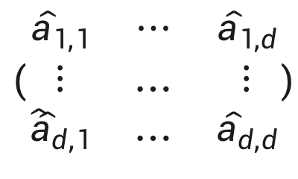
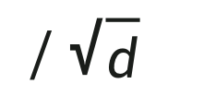
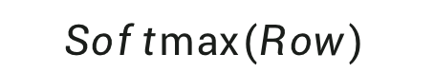
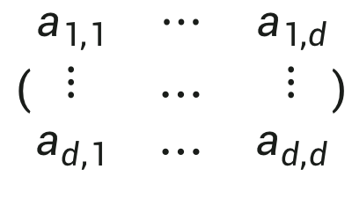
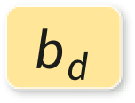
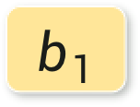
03
Self-Attention
$$\left(\begin{matrix}a_{1,1} & ⋯ & a_{1,d} \\ ⋮ & … & ⋮ \\ a_{d,1} & … & a_{d,d}\end{matrix}\right)$$
$${ q}^{1}$$
=
$${ k}^{1}$$
$${ k}^{d}$$
/$\sqrt{d}$
.
.
.
$${ q}^{d}$$
…
Scaled Dot-Product Attention
$$Softmax⁡(Row)$$
$\left(\begin{matrix}{\hat{a}}_{1,1} & ⋯ & {\hat{a}}_{1,d} \\ ⋮ & … & ⋮ \\ {\hat{a}̂}_{d,1} & … & {\hat{a}}_{d,d}\end{matrix}\right)$
$${\hat{a}}_{1,1}+…+{ \hat{a}}_{1,d}=1$$
$$b_{1}$$
$\left(\begin{matrix}{\hat{a}}_{1,1} & ⋯ & {\hat{a}}_{1,d} \\ ⋮ & … & ⋮ \\ {\hat{a}̂}_{d,1} & … & {\hat{a}}_{d,d}\end{matrix}\right)$
$${ v}^{1}$$
=
.
.
.
.
.
.
$$b_{d}$$
$${ v}^{d}$$

Slide 21
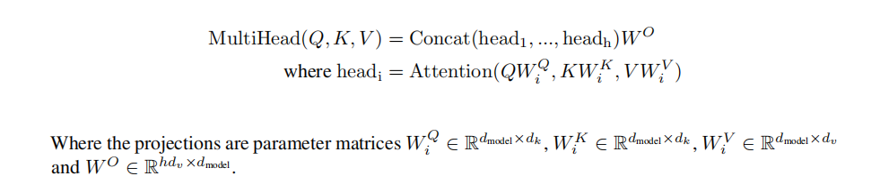
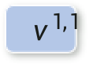
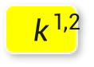
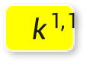
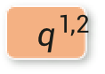
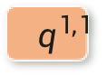
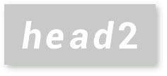
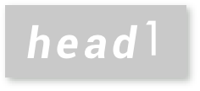










03
Multi-head Self-Attention
$head$1
$$head2$$
$${ q}^{1,1}$$
$${ q}^{1,2}$$
$${ k}^{1,1}$$
$${ k}^{1,2}$$
$${ v}^{1,1}$$
$${ v}^{1,2}$$
$${ q}^{2,1}$$
$${ q}^{2,2}$$
$${ k}^{2,1}$$
$${ k}^{2,2}$$
$${ v}^{2,1}$$
$${ v}^{2,2}$$
$${ q}^{1}$$
$${ k}^{1}$$
$${ v}^{1}$$
$${ q}^{2}$$
$${ k}^{2}$$
$${ v}^{2}$$

Slide 22

03
Complexity
Self-Attention operation has high efficiency and low complexity, only needs a small step size in sequential calculation, and the distance of information from one point to another point is also the smallest, so it has better computing power.

Slide 23


03
Attention is all you need[2]
Performance
Vision Transformer[1]
Figure 1 Similarity of position embeddings of ViT-L/32.
Figure 2 Size of attended area by head and network depth.
[1]Dosovitskiy A, Beyer L, Kolesnikov A, et al. An image is worth 16x16 words: Transformers for image recognition at scale[J]. arXiv preprint arXiv:2010.11929, 2020.
[2]Vaswani A, Shazeer N, Parmar N, et al. Attention is all you need[C]//Advances in neural information processing systems. 2017: 5998-6008.

Slide 24
4
Applications

Slide 25
02
Attention in GNN
Attention in NLP

Slide 26


04
Attention In GNN
Social network
Molecule property prediction
EX1: Will someone buy this product?
EX2: Is this molecule toxic?

Slide 27



04
Attention In GNN
Applying a 3-layer GNN model to
a graph with 7 nodes
If the model layer aggregates information based on attentions, using attention weights as edge weights.
Different depth edges represent different attention weights

Slide 28
04
Attention In GNN
Result
buy
not buy
buy
toxic！

Slide 29



04
Attention In NLP
The whole sequence has a label
EX1: Sentiment Analysis
EX2: Speaker recognition

Slide 30






04
Attention In NLP
Model decides the number of labels itself.
EX1:Speech recognition
EX2:Machine translation
机 器 学 习

Slide 31
Thank You
.
.
.

